Slide 1
COMP90054 AI Planning for Autonomy Workshop Week6
Ruixi
huor@student.unimelb.edu.au

Slide 2
Objectives
Delete Relaxation
Relationship between h*, h⁺, h^{add}, h^{max}, h^{FF}
How to compute h^{add}
How to compute h^{max}

Slide 3

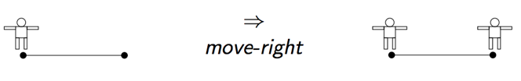

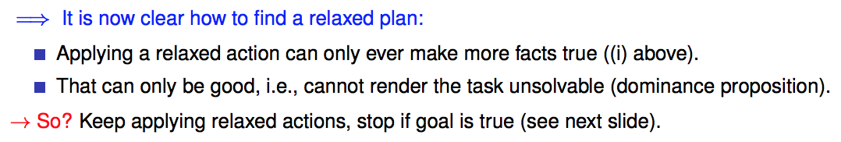
Delete Relaxation
Greedy Relaxed Planning

Slide 4

Relationship between h*, h⁺, h^{add}, h^{max}, h^{FF}
h*
h^{add} or h^{max}
estimate
approximate
h
(h⁺)
Extract a relaxed plan
To compute h^{FF}
approximate
h^{FF}
h⁺: is the optimal delete relaxation heuristic
But h+ is hard to compute

Slide 5
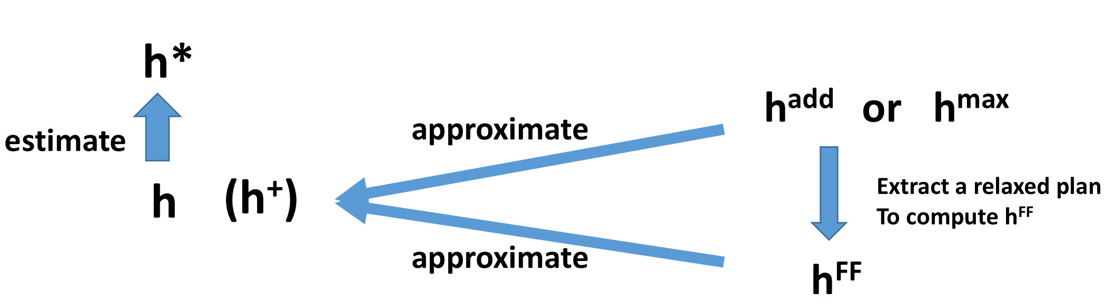
h⁺ is the optimal delete relaxation heuristic
h⁺ is admissible, so h⁺ <= h*
h^{max} is admissible h^{max} <= h*
but far too optimistic. h^{max} is too small. h^{max} <=h⁺
To sum up, h^{max} <= h⁺ <= h*
h^{add} is not admissible(so h^{add} can be larger than h* in some cases)
It is pessimistic. h^{add} overcounts. h^{add} >= h⁺
The properties of h^{FF} is similar with h^{add}, but h^{FF} won’t overcount

Slide 6
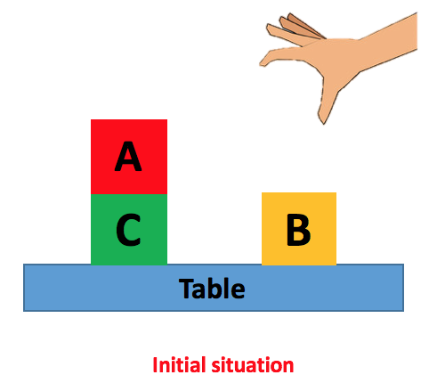
Domain Independent heuristic
Not specific to one problem.
e.g. delete relaxation, goal-counting
Manhattan distance

Slide 7
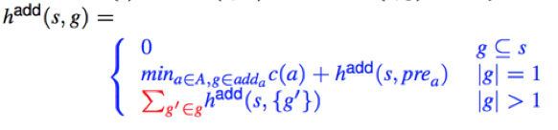
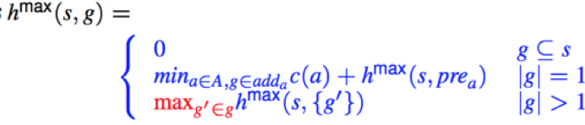
Bellman-Ford Algorithm
How to compute h^{add}
Recursive
Assumption: each goal can be achieved independently
How to compute h^{max}

Slide 8
Bellman-Ford Algorithm
How to compute h^{add}
Recursive
Assumption: each goal can be achieved independently
How to compute h^{max}

Slide 9
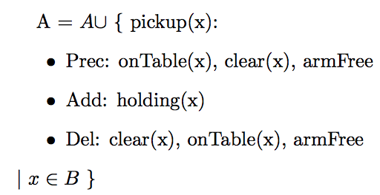
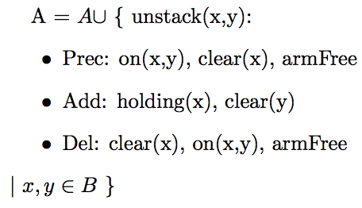
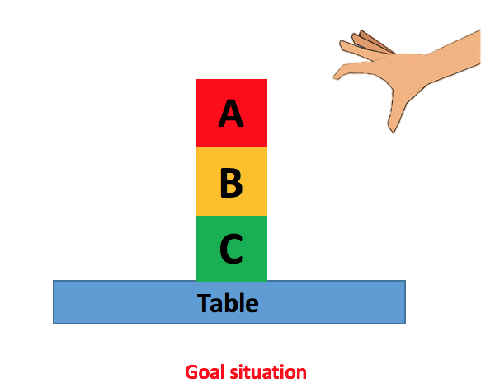
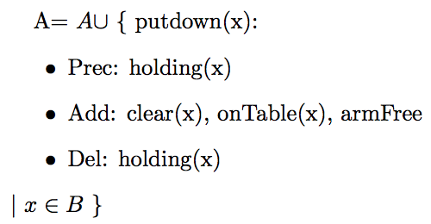
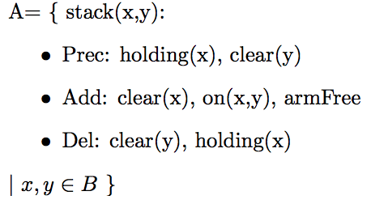
A blocks-world problem – 4 actions
Assume the cost of each action is 1

Slide 10







How to compute h^{add}
 | Cl(A) | Cl(B) | Cl(C) | onT(A) | onT(B) | onT(C) | On(A,B) | On(A,C) | On(B,C) | H(A) | H(B) | H(C) | ArmFree
0
1
2
3
0
0
$$∞$$
$$∞$$
0
0
$$∞$$
0
$$∞$$
$$∞$$
$$∞$$
$$∞$$
0
Initial Situation :
I = {on(A,C), onTable(C), onTable(B), clear(A), clear(B), armFree}
Cl(A)means Clear(A)
onT(A) means onTable(A)
H(A) means holding(A)

Slide 11
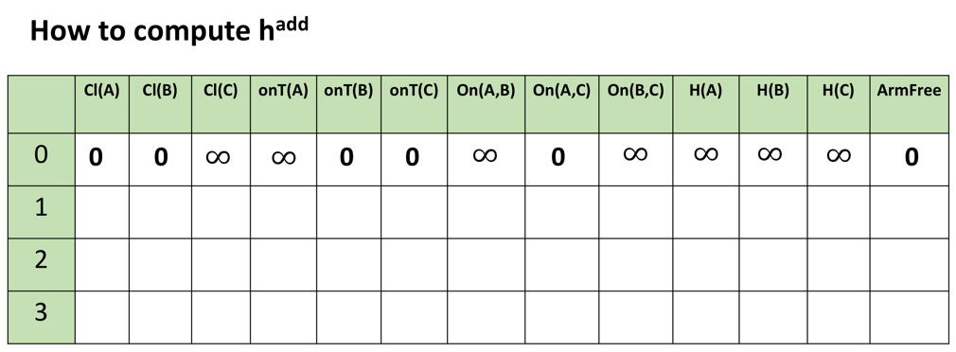
0
0
0
0
0
0

Slide 12
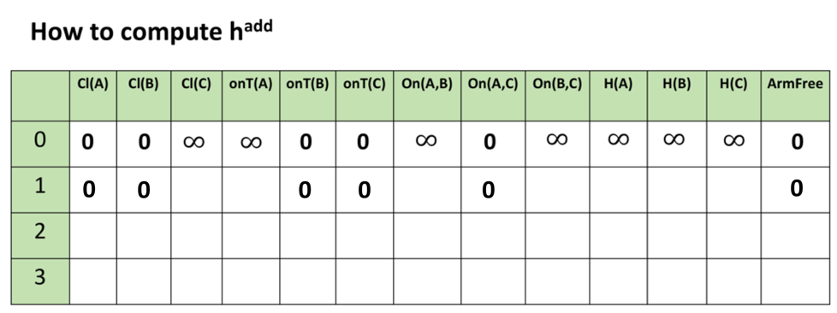
What (one) action can make clear(C) True?

Slide 13
A blocks-world problem – 4 actions

Slide 14
1
What (one) action can make clear(C) True?
unstack(A,C), unstack(B,C), putdown(C), stack(C,A), stack(C,B)

Slide 15
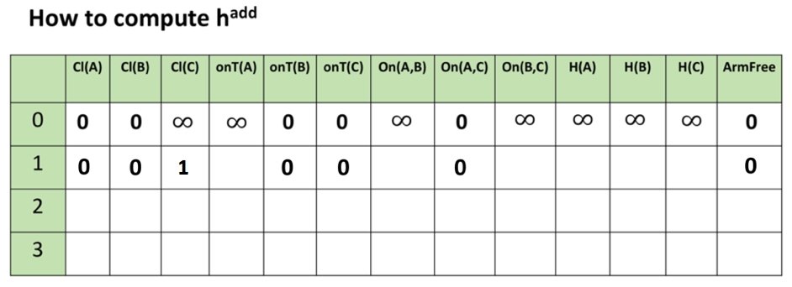



$$∞$$
What (one) action can make onTable(A) True?
Preconditions:
holding(A)
putdown(A)
$$∞$$
1
+
$$∞$$
=

Slide 16
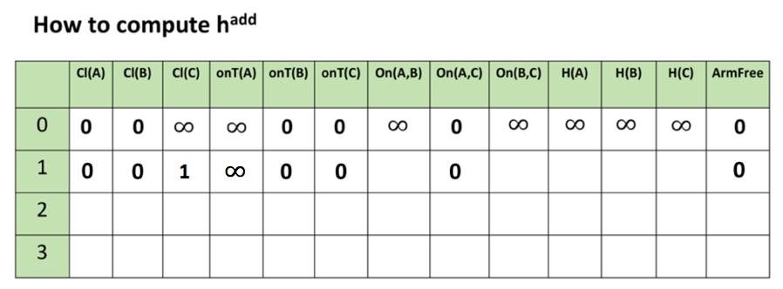



$$∞$$
$$∞$$
1
1
$$∞$$

Slide 17
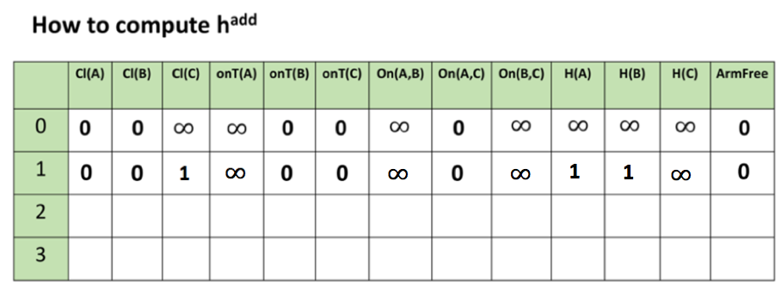

0
0
1
2
0
0
0
1
1
0
What (one) action can make onTable(A) True?
Preconditions:
holding(A)
putdown(A)
=
2
1
+
$$1$$

Slide 18
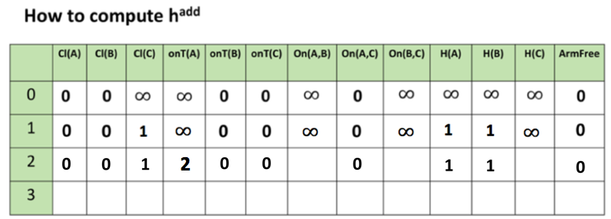
2
3(2)
2
add(max)
What (one) action can make on(B,C) True?
Preconditions:
holding(B)
clear(C)
1
stack(B,C)
h^{add} = 3
h^{max}=2
1
1

Slide 19
add(max)
2
3(2)
2
After we have get all the values in iteration 2. We shouldn't stop.
When to stop?
Converge
When the values of last two iteration are exactly the same

Slide 20
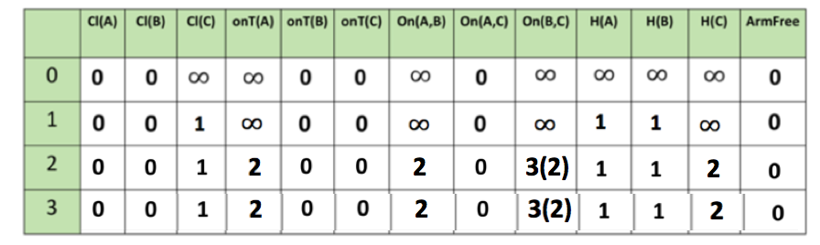
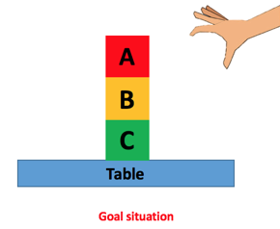
Last Step: Get h^{add} or h^{max}
add(max)
|G| = 4
> 1
h^{add} (I) = sum(0, 2, 3, 0) = 5
approximate
h+
h^{max} (I) = max(0, 2, 2, 0)= 2

Slide 21
